Slide 1
Implementing Research-Informed Assessment Feedback Practice
©Carol Evans
January 21, 2016 Building 32 (2115) 4-5pm
D O’Connor Scarlet Symphony

Slide 2
Outline
What do we know about key principles underpinning effective assessment feedback designs?
What lessons can we can learn from current innovative assessment designs?
Can the (EAT) evaluation tool help to explore dimensions of assessment feedback practice?

Slide 3
Does Feedback Work?
usually but not always (DeNisi & Kluger, 2000)
no simple answer (Shute, 2008)
no general agreement (Nelson & Schunn, 2008)
the wrong question to ask (Sadler, 2003, 2010)
BUT - generally agreed principles (Evans, 2013, 79).

Slide 4
http://rer.sagepub.com/content/83/1/70.full.pdf+html

Slide 6
Things to Think About
Different starting points of students and their self-regulatory capacity
Volition of students
Feedback histories
Fitness for purpose of assessment & feedback
Efficiency
Sharing intentions

Slide 7
Core Questions
What does student engagement in assessment and feedback look like?
How can we promote this through holistic assessment designs?
The emphasis has to be on promoting self-regulatory designs

Slide 8
Feedback Gap
Between receiving and acting on feedback:
Complexity of how students make sense of, accept, and use feedback;
Emotional impact of feedback;
Ability to use feedback / appropriateness;
Previous experiences;
Goals;
Beliefs about the role of feedback;
Agency;
Networks;

Slide 10
Repositioning Assessment Feedback
Co-constructed nature of feedback as dialogue between students
and lecturers;
the use of multiple sources of feedback - with the lecturer not necessarily being the dominant source of feedback but more the facilitator of student access to, and navigation and use of networks;
a move from individualistic to collective learning through, for example, peer feedback mechanisms;
assessment feedback as a fully integrated element of assessment rather than as a series of isolated events (Boud & Molloy, 2013; Yang & Carless, 2012; Evans, 2013).

Slide 11
Current Considerations
Real Assessment
Students as Partners
Student engagement with peer learning
Role of research – inquiry based learning
Meaningful Products
Transfer
Employability
Deep Learning
Manageable
https://www.heacademy.ac.uk/resource/engaged-student-learning-high-impact-strategies-enhance-student-achievement

Slide 12
A Personal Learning Styles Pedagogy Approach
(A) Exploration of student and lecturer beliefs about the value of a specific assessment feedback approach
(B) An appreciation of the fact that learners have different needs in relation to assessment feedback practice and an awareness of difference in relation to how individual’s process information and the relevance of this to feedback.
(C) It is research informed and considers feedback, feedforward and feed up.
(D) The promotion of student and lecturer agency ; an increasing emphasis on the nature of the role of the student and lecturer in feedback exchanges; the importance of, and strategies for, supporting students in developing self -assessment skills.
(E) Assessment feedback is seen as an integral part of learning and teaching.

Slide 13
References
Waring and Evans (2015) Understanding Pedagogy http://www.amazon.co.uk
/Understanding-Pedagogy-Developing-critical-approach/dp/041557174X
Evans, C., & Waring M. (2015). Using an informed understanding of styles to enhance learning and teaching in 21st century learning environments. In: R. Wegerif, J. Kauffman, and L. Liu. Handbook of Research on Teaching Thinking (pp. 137-150). London: Routledge.
What lessons can we can learn from current innovative assessment designs
Can (EAT) evaluation tool help to explore dimensions of assessment feedback practice

Slide 14
Cultivating a Deep Approach to FB / FF
Meaning making – ‘understanding principles v going through the motions’
Self management (prioritising workload / targets)
Perspective (making sense of feedback – filtering)
Noticing (making the most of opportunities)
Resilience (self awareness – self monitoring)
Management of personal response to feedback (fit within organizations/personal adjustment – self-concept/ identity)
Personal responsibility in FB/ FF process
Adaptability (ability to transfer and adapt feedback to different contexts)
Forward Thinking (Evans, 2013b)

Slide 15
Making Effective Use of Feedback
Focused specific feedback
Student engagement: students asked to request 3 things they wanted feedback on.
No feedback on full drafts – just on proposal outlines – done early on in programme.
Identification of networks of support at start.
Direction to networks.
Information sent prior to all taught sessions with key tasks.
Students asked in summative work to reflect on how they have met the criteria; what areas they still have issues with; where they would like more support; effectiveness of their feedback to others and how they have used feedback received.
Explicit discussion of learning process: self-regulation; assimilation into professional learning communities.
Authentic assessment – based o n what the students had identified as a priority in order to develop themselves within and beyond HE.

Slide 16
Foci for research
Identification & interpretation of student learning transitions in relation to receptivity to and ability to use and give feedback;
Dynamics involved in both the giving and receiving of feedback;
Cognitive and affective dimensions in interpretation of feedback;
Relationships between individual and contextual variables (with greater attention placed on the subject specific requirements of feedback and roles of culture, gender and other ILDs);
Role of feedback in the development of self-concept (Bereiter, 2002);
Nature of feedback networks and communication flows;
Specifics on how tools can be used to assist development of co- and self-regulation.

Slide 17
Exploring Practice
in the workload model?

Slide 18
Assessment Practice Foci
Assessment Tool (EAT)
12 dimensions related to 3 key areas:
Assessment Literacy (AL)
Facilitating Improvements in Learning: Feeding Forward and Up (FIiL)
Holistic Assessment Design (HAD)

Slide 20
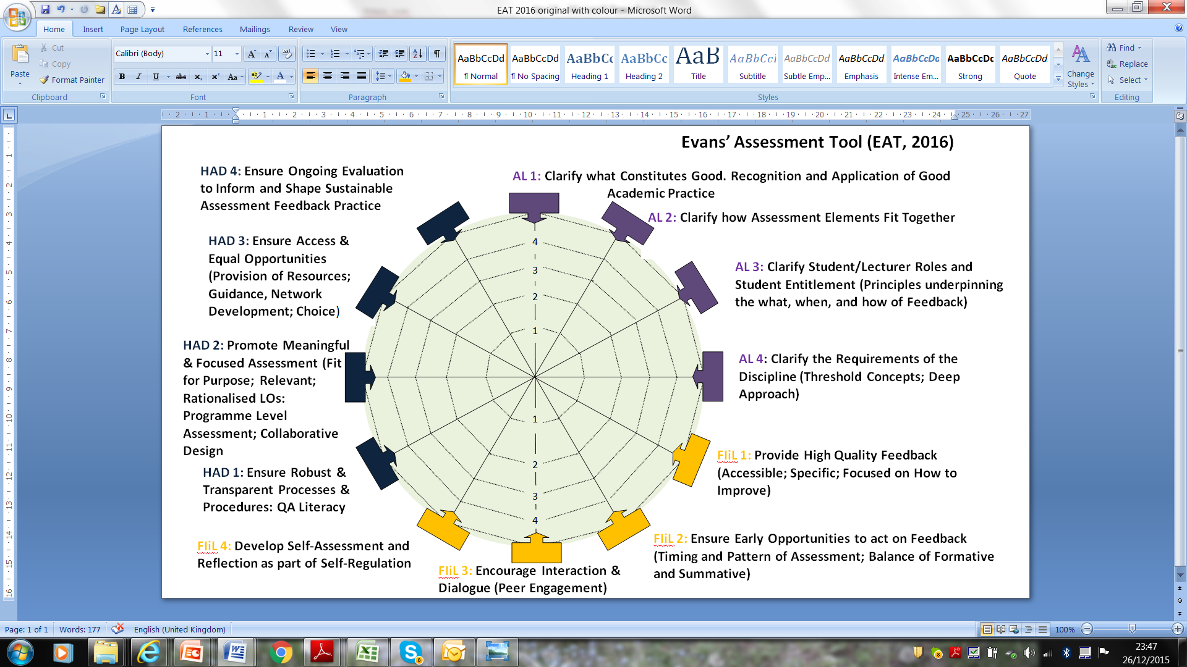

Slide 21
Bespoke training

Slide 22
Contact (c.a.evans@soton.ac.uk) if you want to be a RAP discipline representative / and or to join the RAP mailing list

